Slide 1
REMOTE LABS
ESW Project
Team 4-Mation

Slide 2
TeaM MEmbers
Keerthi
Meghana
Harshitha
Srihitha

Slide 3
our project
Our Project Remote Labs aims at providing an opportunity for people in remote places to perform experiments.

Slide 4
our approach
Our project provides users to perform experiment on DC Motor and analyze voltage vs RPM characteristics. User can vary the voltage from dashboard where voltage vs RPM graph and live streaming are provided for better user experience.

Slide 5
progress
Step 1
Step 2
Step 3
Step 4
Step 5
Hardware using breadboard and interactive input is done.​​
​
Pushing data into Thingspeak and
video streaming is done.
Soldering of
Hardware and made changes to dashboard for our requirements
User login,
Timer
OM2M,Pushing data from Dashboard into Thingspeak and retrieving data from it

Slide 6
WOrk distribution
Keerthi-Circuit Building, Sensor interfacing(Arduino coding),Soldering
Meghana-Circuit Building, video streaming, Soldering, User login
Harshitha-Dashboard implementation, Thingspeak, user login
Srihitha-Dashboard implementation, OM2M, User login

Slide 7
SOFTWARE

Slide 8
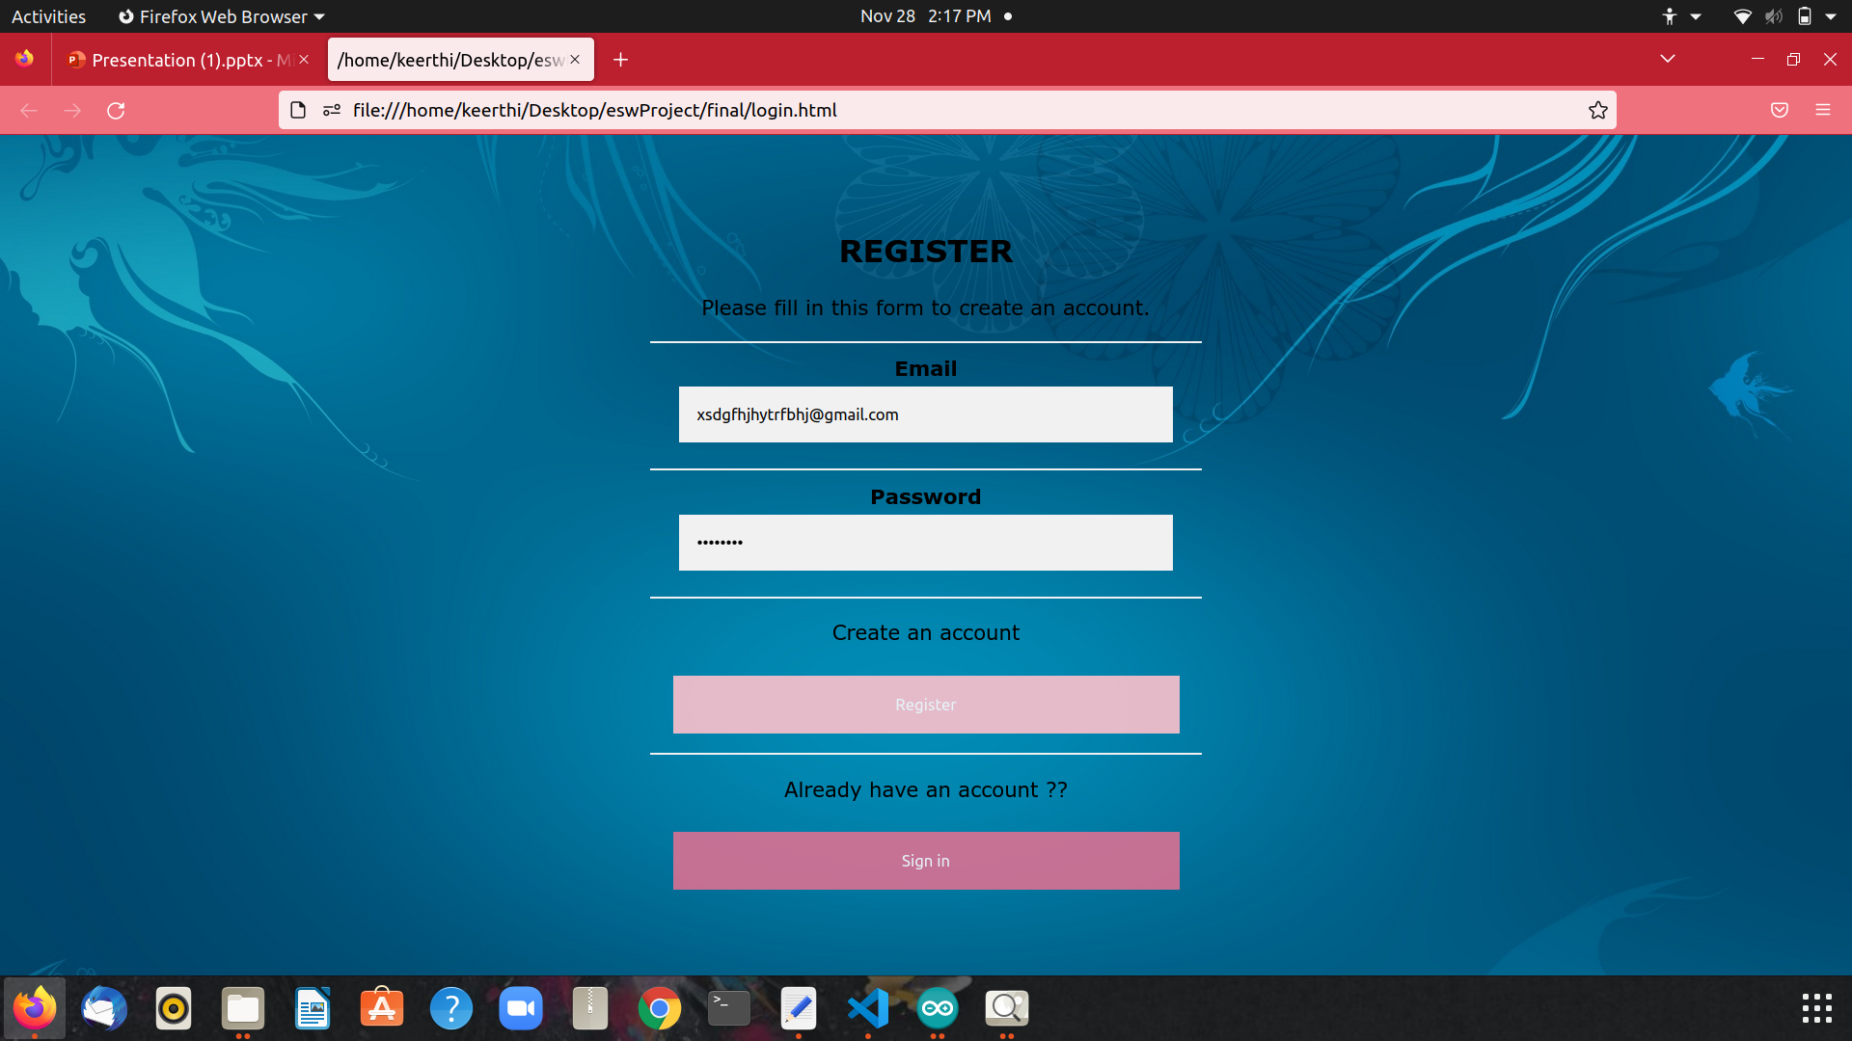
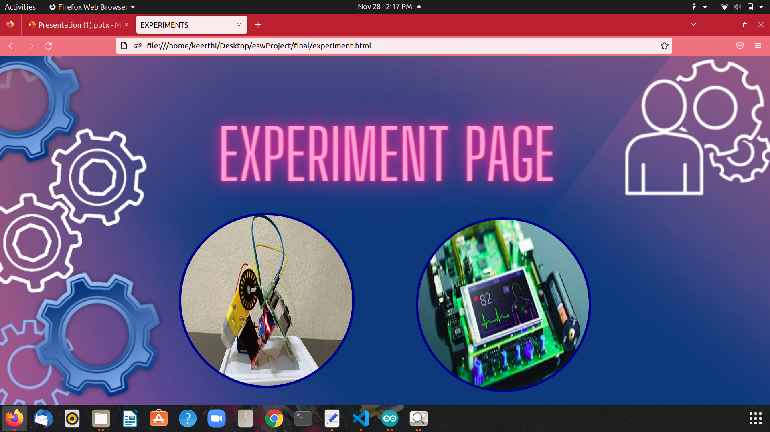
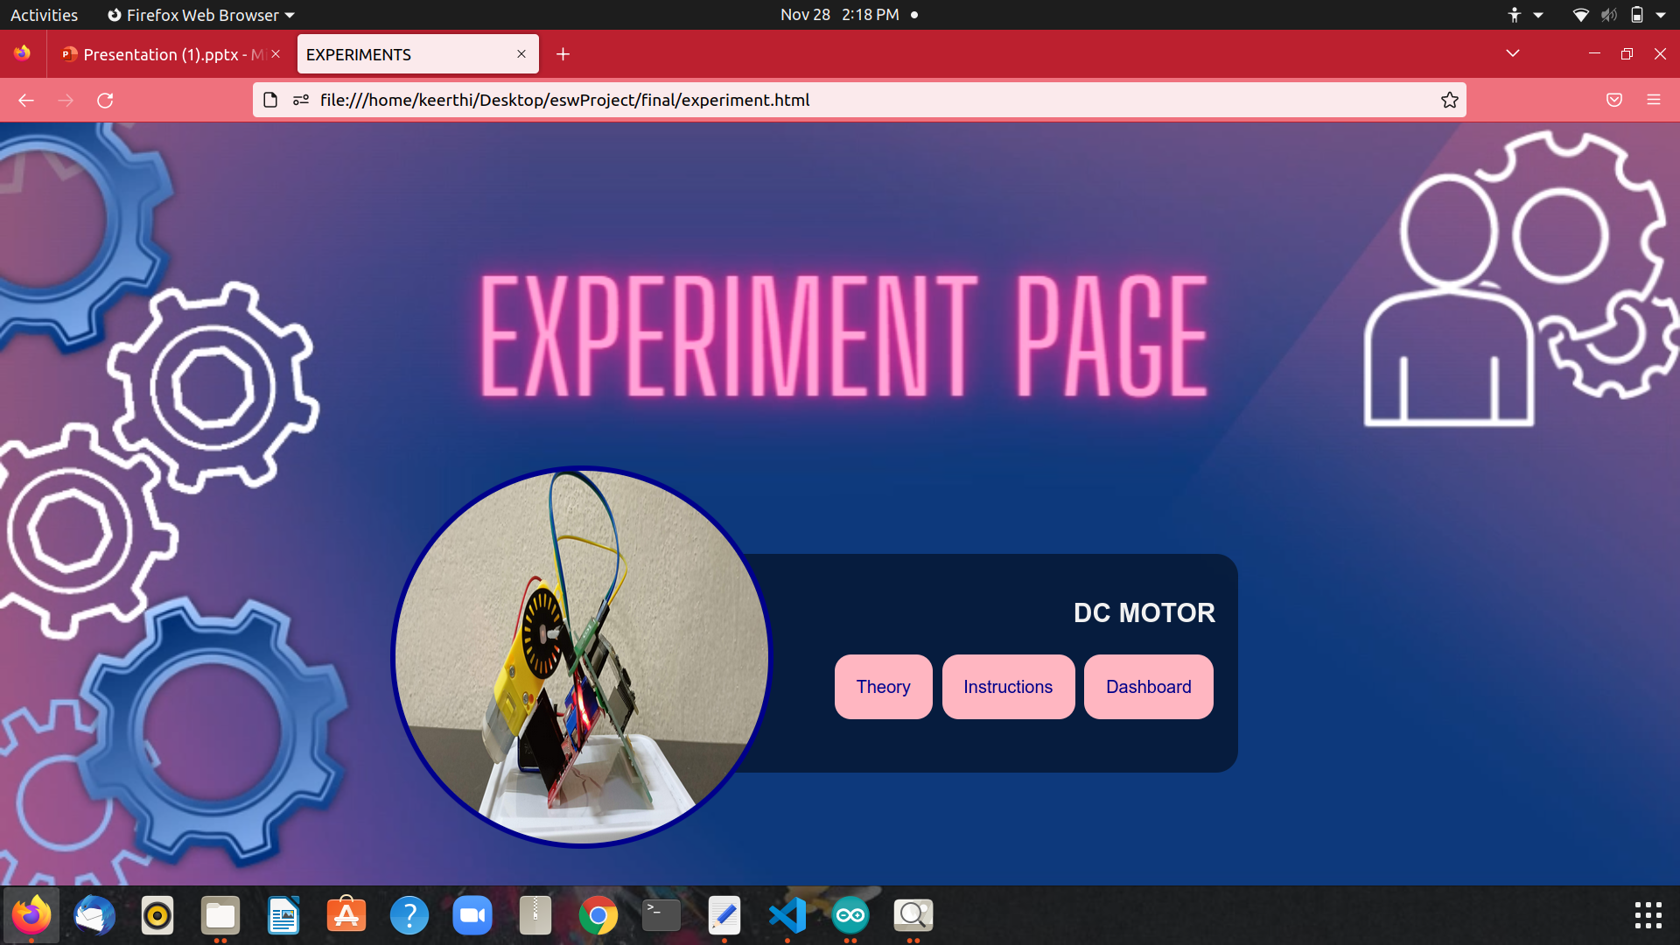
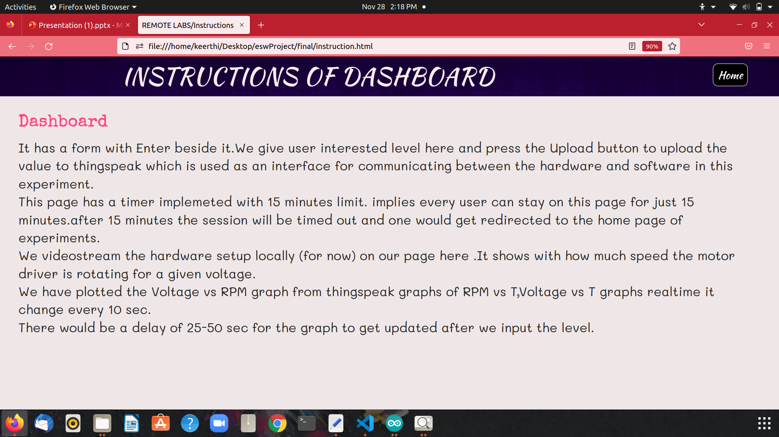
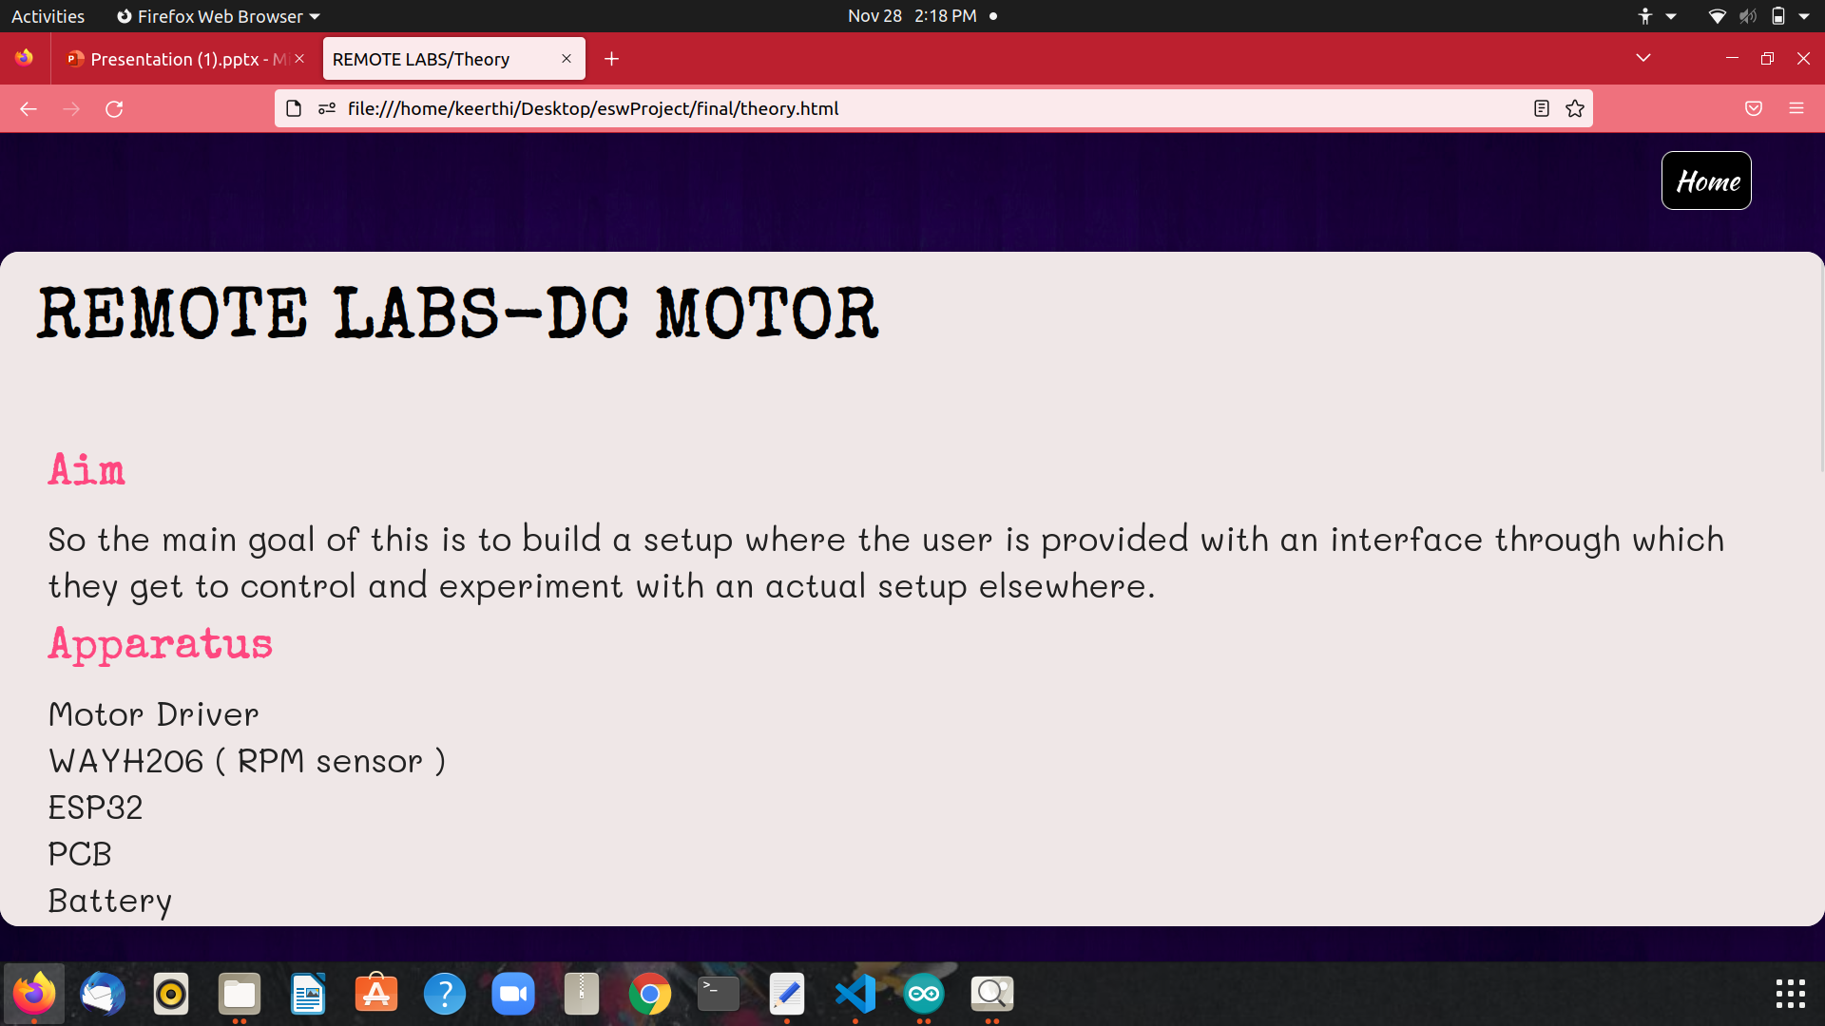
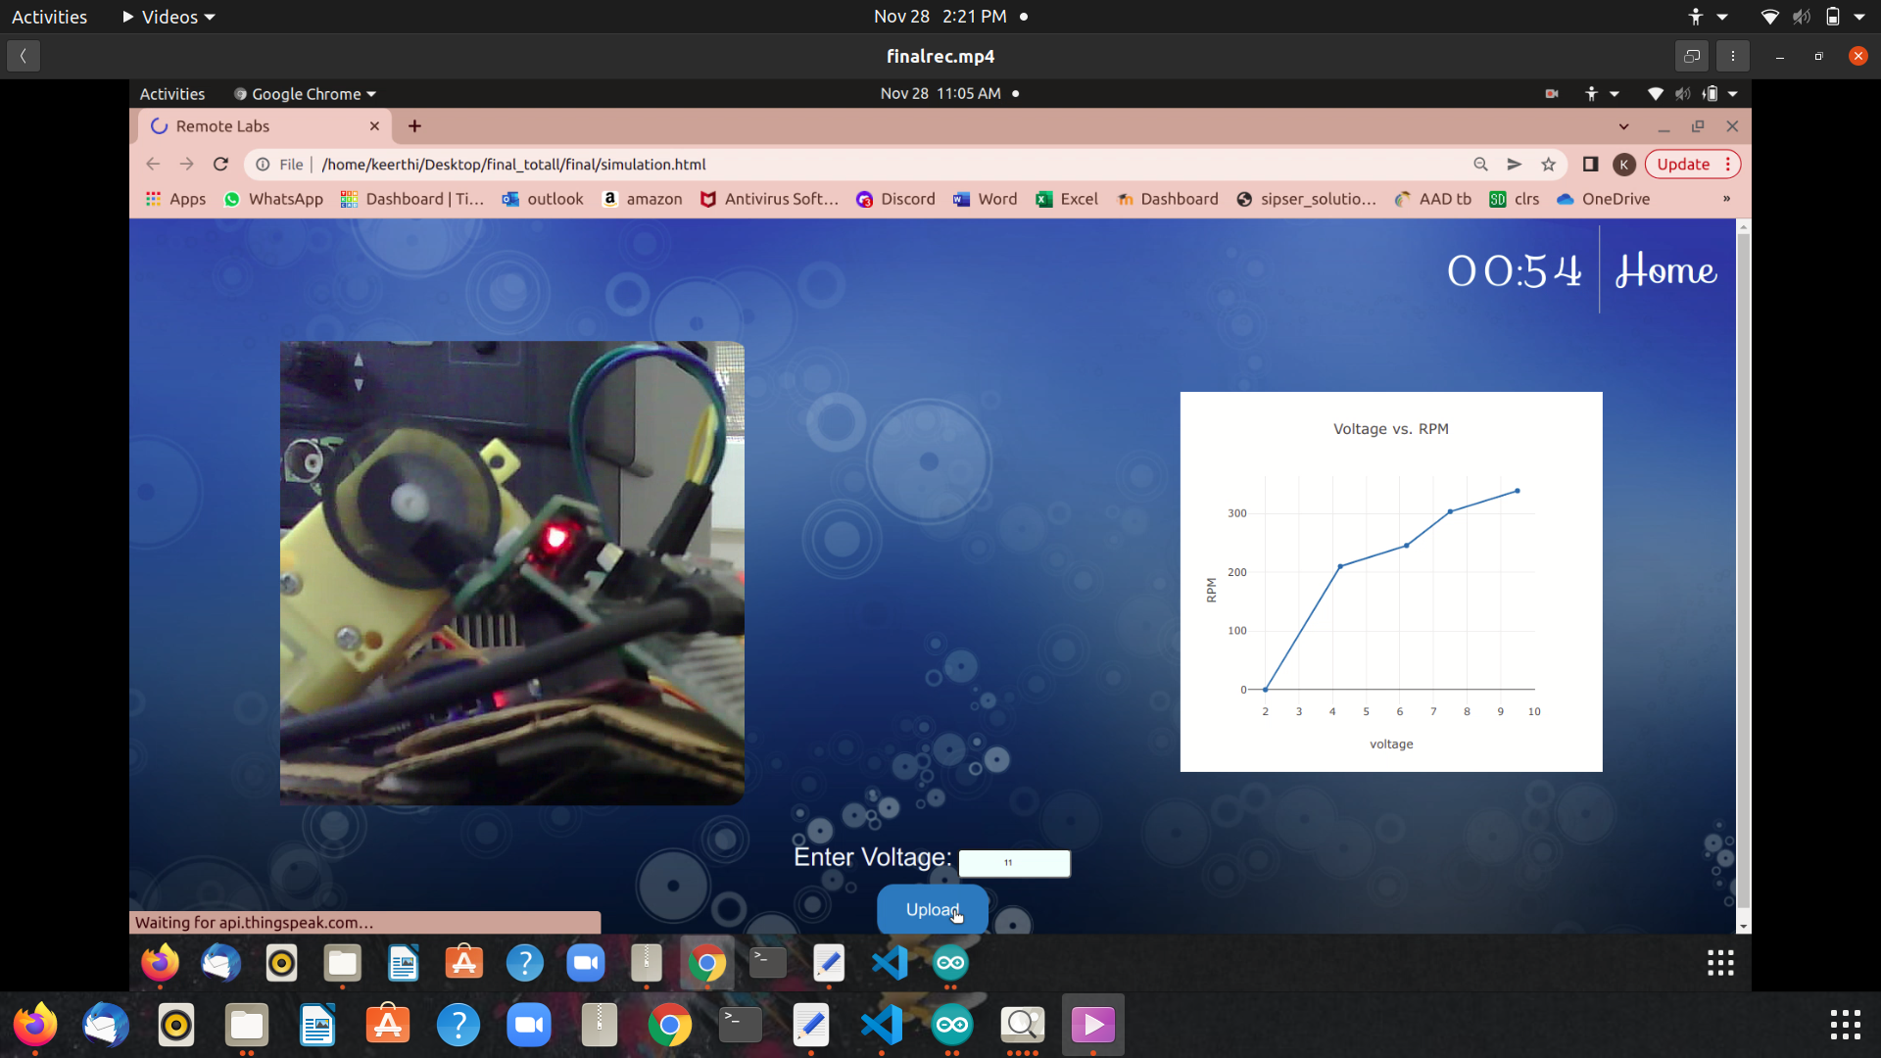
OUR DASHBOARD

Slide 9
Software-frontend
Users should Register and log in to access the website.
User will be led to a page where he can choose experiments of his choice.
Each experiment has a theory, instruction and dashboard page.
User has a time limit of 15min to access the dashboard.
User can enter his desired voltages on Dashboard and analyze from the voltage vs RPM plot and the live streaming available.
Dashboard is restricted to a single user at a time.

Slide 10
Software-backend
Voltage entered by the user on dashboard will be uploaded to Thingspeak.
The voltage value is then read via ESP from thinkspeak.
Measured RPM and output voltage will be uploaded to Thingspeak and Om2m.
We fetch data from thingspeak and plot the Voltage vs RPM graph using plotly.
We used firebase as backend to validate the user authentication.
Since firebase is an online Realtime database we used this for our users email storing and verification.

Slide 11
HARDWARE

Slide 12
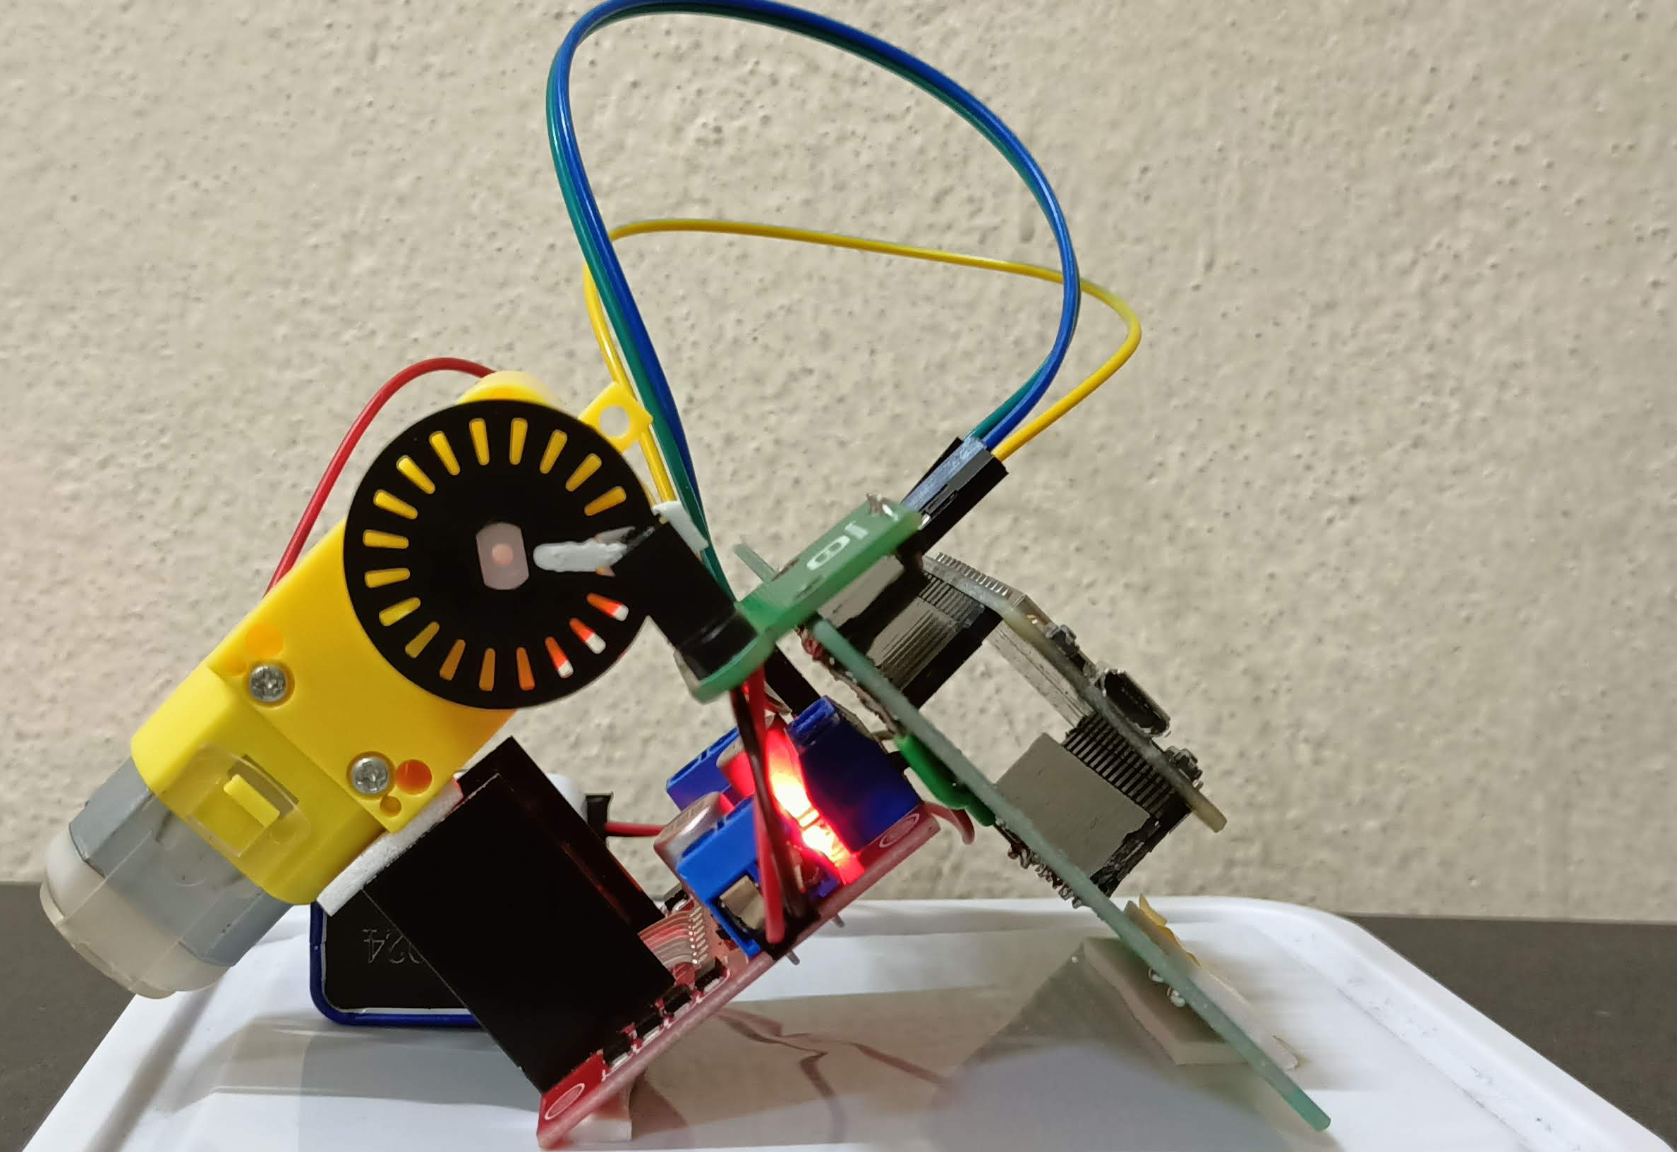
Hardware components
DC MOTOR
MOTOR DRIVER
IR Receiver and Transmitter
ESP32
PCB+WIRES+POWER SUPPLY

Slide 13
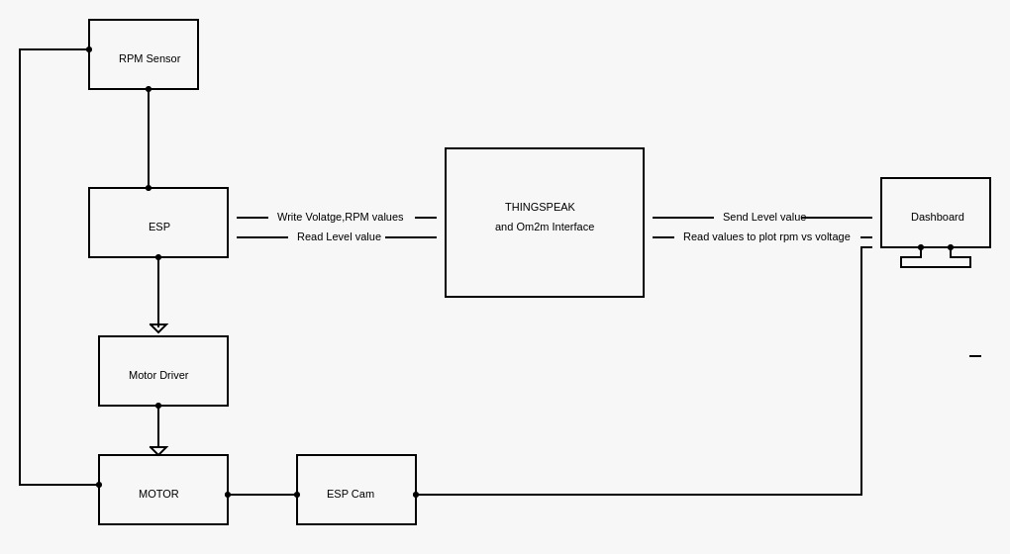
Block diagram

Slide 14
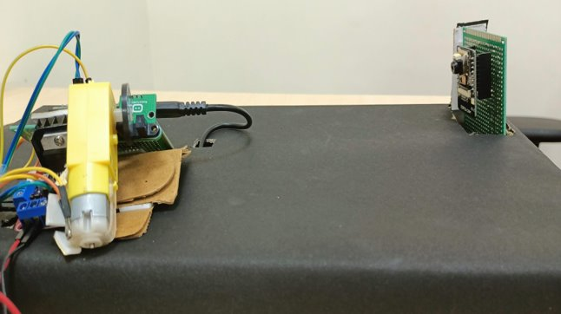
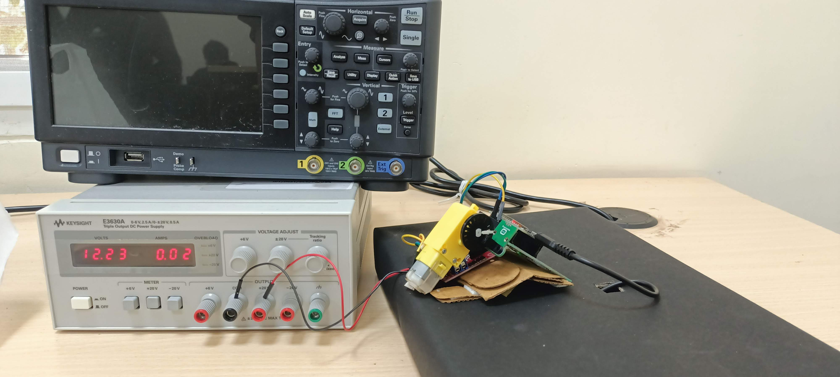
Our setup

Slide 15
hardware
The user enters voltage values via dashboard.
Corresponding duty cycle will be calculated using this formula,
Duty cycle = (voltage*256)/12
RPM will be calculated using signal detection.
Since the encoder is a slotted wheel with 20 slots, the sensor will detect 20 signal variations in one full rotation.
Higher the voltage entered, greater the duty cycle which results in higher Rotations and hence RPM.
User gets to analyze that voltage is proportional to RPM value.

Slide 16
Hardware ANALYSIS
LOADING EFFECT
According to the principles of motor driver, it produces pulses with a given frequency as a result a major amount of voltage will be consumed and not all the voltage will be supplied to the motor.
As the frequency increases, the number of pulses will increase which results in larger voltage differences. The input voltage as in, the duty cycle will be calculated on the given input which is supposed to be given as output but after the pulses, the actual voltage will be different.
As a result of which, battery would drain out soon and will not suffice our requirement of providing constant voltage so, we are using power supply as it can provide a constant power supply of 12V.
We have analyzed these values using multimeter and our final voltage vs RPM graph will be plotted using these estimated voltages.

Slide 17
OBSERVED VOLTAGE VS FREQUENCY VALUES
Voltage / Frequency | 100 | 80,000
1 | 0.6 | 0.06
2 | 3.5 | 0.14
3 | 5.5 | 0.2
4 | 6.8 | 0.3
5 | 7.6 | 0.4
6 | 8.3 | 2
7 | 8.7 | 4.2
8 | 9 | 6.2
9 | 9.4 | 7.5
10 | 9.7 | 9.5
11 | 10 | 10.59
12 | 10.4 | 10.62

Slide 18
THANK YOU

